Slide 1
SINA 2024 Slides Kit
Management of Asthma in Adults
On behalf of the SINA panel
Mohamed S. Al-Moamary, FRCP (Edin) FCCP
Dep. of Medicine, King Abdulaziz Medical City-Riyadh
King Saud bin Abdulaziz University for Health Sciences
Note: for references, please refer to the full document at: Al-Moamary MS, Alhaider SA, Allehabi R, Idrees MM, Zeitouni MO, Al Ghobain MO, Alanazi AF; Al-Harbi AS, Yousef AA, Alorainy HS, Al-Hajjaj MS. The Saudi Initiative for Asthma - 2024 update: Guidelines for the diagnosis and management of asthma in adults and children. Ann Thorac Med 2024;196: in press

Slide 2
Out-patient Management of Asthma in Adults
Enter presenter name
Enter the presenter’s institute

Slide 3
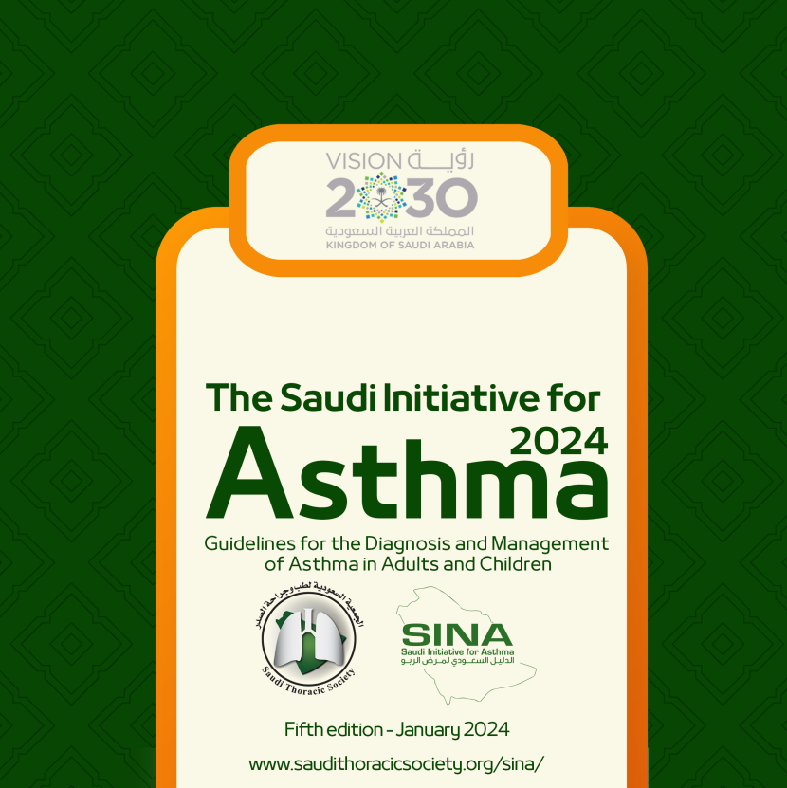
Disclaimers
SINA guidelines, developed by the Saudi Initiative for Asthma panel, are not meant to replace clinical judgments of physicians but to be used as tools to help the practicing physicians to manage asthma patients
Although a lot of effort was exerted to ensure the accurate names and doses of medications, the authors encourage the readers to refer to the relevant information of specific drugs for further clarification
SINA panel is fully sponsored by the STS

Slide 4
What is SINA?
SINA is developed by a task force originated from the Saudi Initiative for Asthma Group under the umbrella of the Saudi Thoracic Society
SINA is a practical approach for a comprehensive management of asthma in adults and children and when to refer to a specialist
Directed to HCW dealing with asthma who are not specialists in the field.

Slide 5
Purpose of SINA
To provide a document that is easy to follow, simple to understand yet totally updated and carefully prepared for use by non-asthma specialist including primary care doctors and general practice physicians

Slide 6
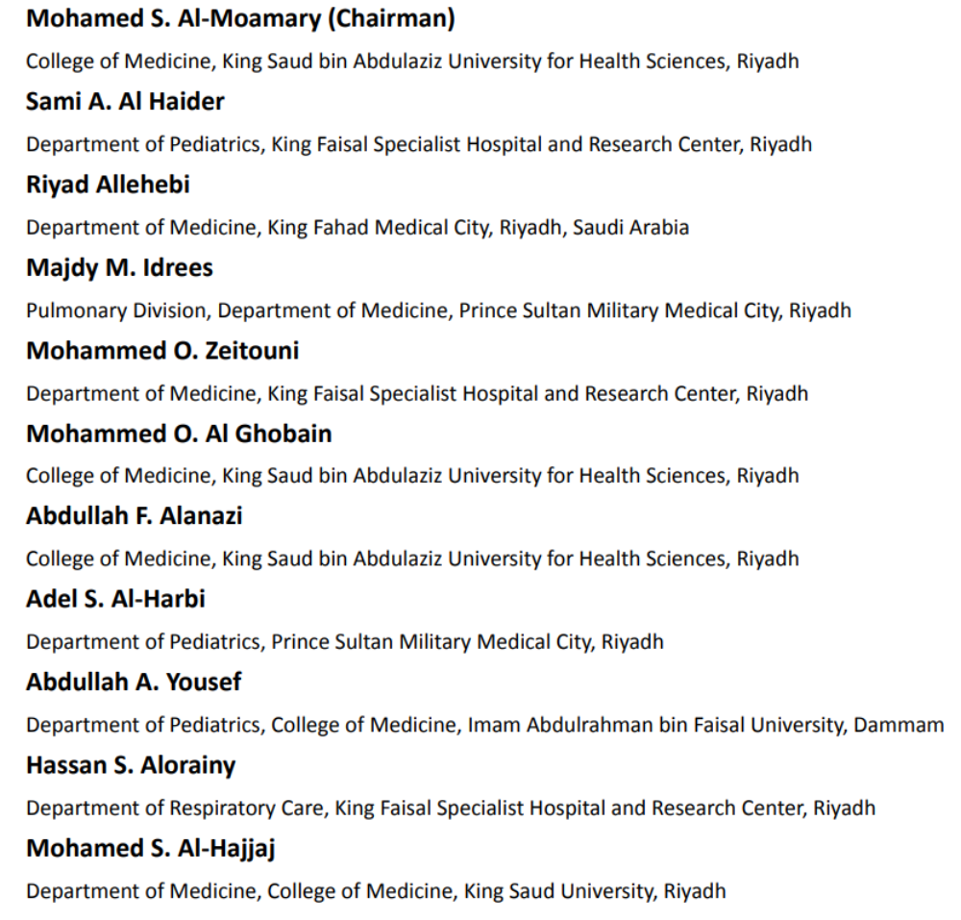
SINA 2024 Panel

Slide 7
Where do you find and cite SINA 2024?
The SINA guideline was published in the Annals of Thoracic Medicine (www.thoracicmedicine.org):
Al-Moamary MS, Alhaider SA, Allehabi R, Idrees MM, Zeitouni MO, Al Ghobain MO, Alanazi AF; Al-Harbi AS, Yousef AA, Alorainy HS, Al-Hajjaj MS.
The Saudi Initiative for Asthma - 2024 update: Guidelines for the diagnosis and management of asthma in adults and children. Ann Thorac Med 2024;19: in press
The SINA booklet is available at: http://saudithoracicsociety.org/sina/

Slide 8
Process of Updating SINA 2024?
The sixth version of SINA
SINA approach for different age groups is based on assessment of symptom control and risk
The guidelines have focused more on:
  Personalized approaches
  Better understanding of disease heterogeneity
  Integration of recommendations related to biologic agents
  Evidence-based updates on treatment role of immunotherapy in management

Slide 9
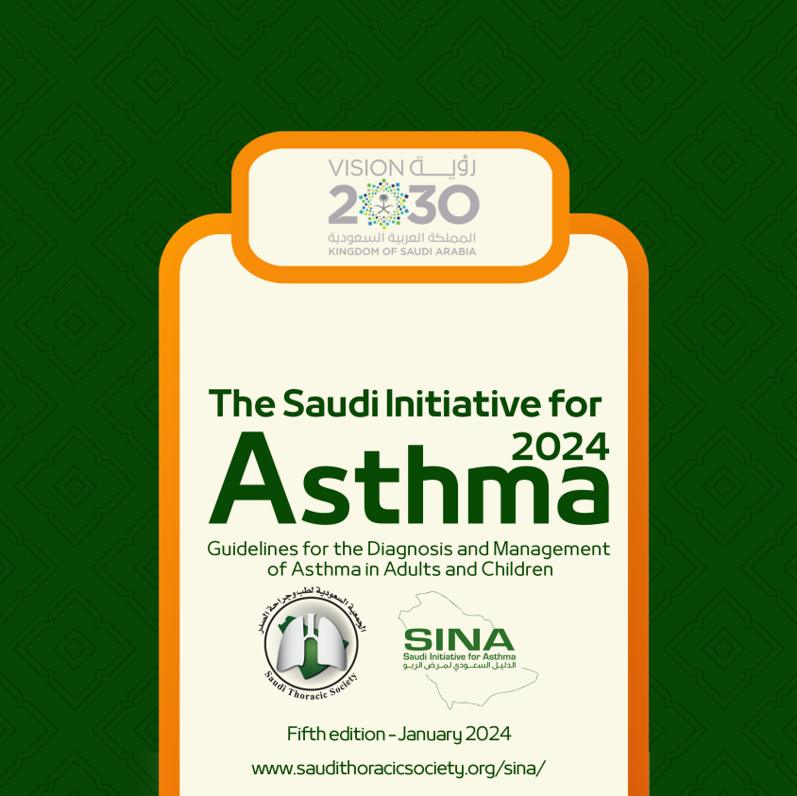
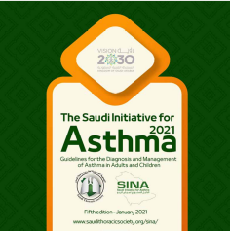

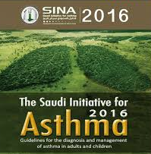
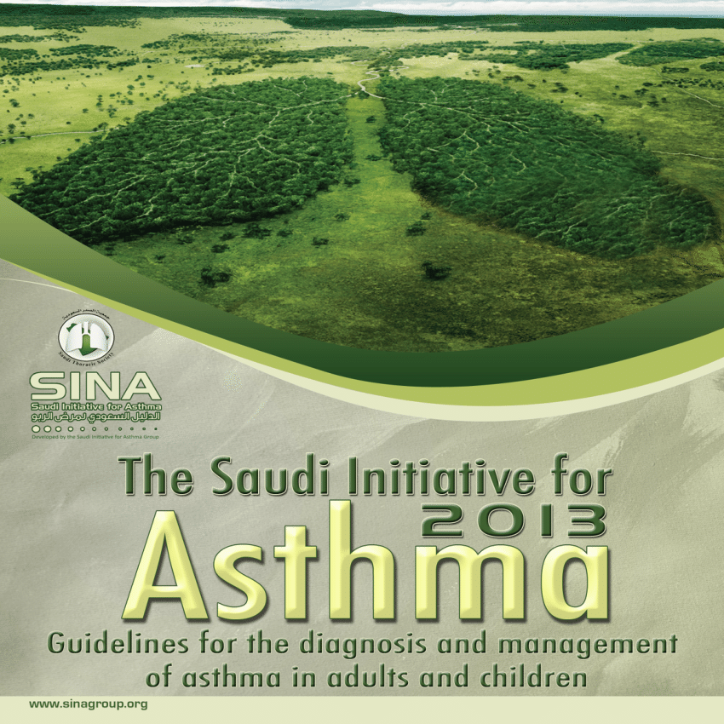
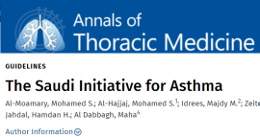
History of Saudi Initiative for Asthma (SINA)
Developed by a task force originated under the umbrella of the Saudi Thoracic Society
SINA is a practical approach for a comprehensive management of asthma in adults and children and
Directed to HCW dealing with asthma who are not specialists in the field.
Sixth Version: 2024
Fifth Version: 2021
Fourth Version: 2019
Third Version: 2016
Purpose
Second Version: 2012
To provide a document that is easy to follow, simple to understand yet totally updated and carefully prepared for use by non-asthma specialist including primary care doctors and general practice physicians
First Version: 2009

Slide 10
SINA Documents
Published manuscript
Booklet
Electronic version
Slides kit
Flyers
Website: http://saudithoracicsociety.org/sina/

Slide 11
Saudi Thoracic Society commitment
The STS is committed to improve the care of asthma by a long-term plan:
  Periodic scientific meetings
  Annual asthma meeting
  Frequent asthma courses
  Educational brochures
  Publishing new and updated asthma guidelines
  Partnership with health care provides

Slide 12
What is New in SINA 2024?
Overall review and update of SINA guidelines with emphasis on:
New concepts on asthma treatment algorithms
Redefining Reliever therapy in mild asthma
Updating controller therapy especially in severe asthma
Evidence based update of biologics and addition of new biologics
Including new biologics for children

Slide 13
Sections of SINA
Introduction: Epidemiology, Methods, and Pathophysiology of Asthma
Diagnosis of Asthma in Adults and Adolescent
Clinical Assessment in Adults and Adolescents
Non-pharmacological Management
Pharmacological Management in Adults and Adolescent
Asthma in Special Situations
Management of Asthma in Children
Management of Acute Asthma in Children
Medications Used in Asthma Treatment

Slide 14
Asthma Definition
Asthma is a chronic heterogeneous disease usually characterized by chronic airflow limitation. It is defined by the history of respiratory symptoms such as wheeze, shortness of breath, chest tightness and cough that vary over time and in intensity, together with variable expiratory airflow limitation

Slide 15
Pathology of Asthma
Inflammation
Airway Hyper-responsiveness
Airway Obstruction
Symptoms of Asthma

Slide 16
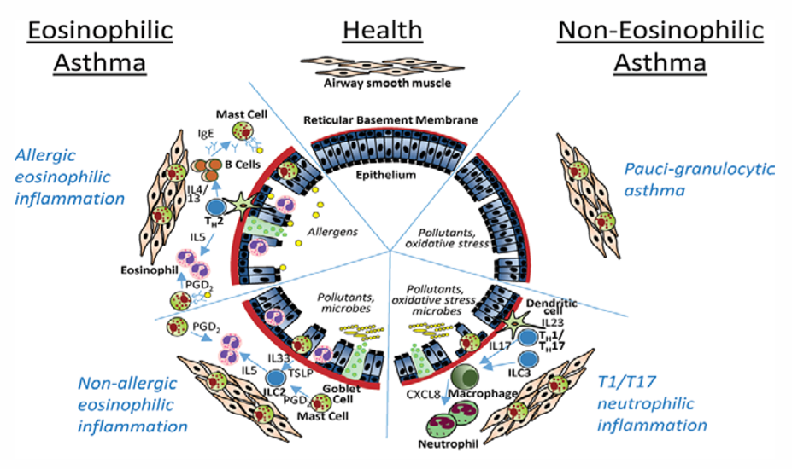
Pathophysiology of Asthma

Slide 17
Diagnosis - History
Episodic attacks:
      Cough
      Breathlessness
      Wheezing
  Nocturnal symptoms
Patient could be asymptomatic between attacks
Co-existent conditions: GERD, rhinosinusitis

Slide 18
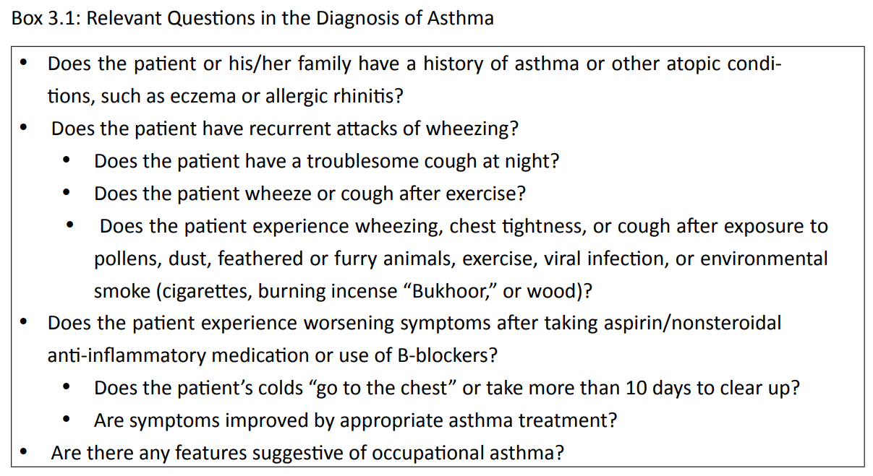

Slide 19
Physical Examination
Normal between attacks
Bilateral expiratory wheezing
Examination of the upper airways
Other allergic manifestations: e.g., atopic dermatitis/eczema
Consider alternative Dx when there is localized wheeze, crackles, stridor, clubbing

Slide 20
Investigations
Measurements of lung function:
      Spirometry
      Peak expiratory flow (PEF)
  Ensure significant reversibility
Normal Spirometry does not role out asthma
Spirometry is superior to PEF

Slide 21
Bronchodilator response
Proper instructions on how to perform the forced expiratory maneuver must be given to patients, and the highest value of three readings taken
The degree of significant reversibility is defined as an improvement in FEV₁ ≥12% and ≥200 ml from the pre-bronchodilator value

Slide 22
Clinical Assessment
Assess allergic status to identify risk factors (if indicated)
Chest X-ray is not routinely recommended
Routine blood tests are not routinely recommended
IgE measurement and eosinophils count is indicated in moderate-severe cases

Slide 23

Differential Diagnosis
airways
  Viral bronchiolitis or obliterative bronchiolitis
  Cystic fibrosis
  Bronchopulmonary dysplasia
  Heart disease
Other causes
  Recurrent cough not due to asthma
  Aspiration from swallowing mechanism dysfunction or GERD
Upper airway diseases
  Allergic rhinitis and sinusitis
Obstructions involving large airways
  Foreign body in trachea or bronchus
  Vocal cord dysfunction
  Vascular rings or laryngeal webs
  Laryngotracheomalacia, tracheal stenosis, or bronchostenosis
  Enlarged lymph nodes or tumor

Slide 24
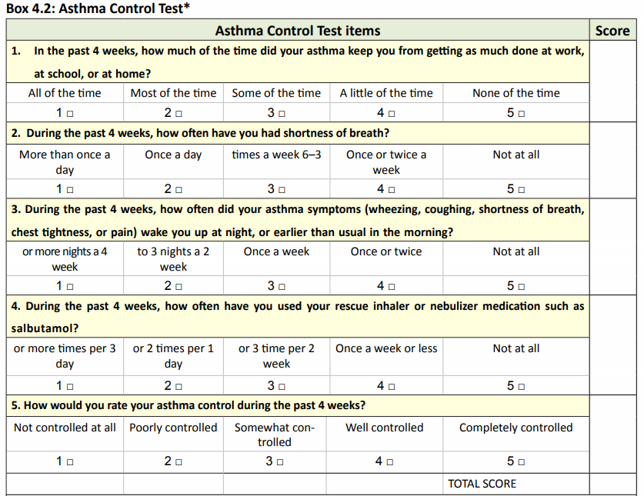
Assessment of Asthma Control
Level of Control:
Control: 20-25
Partial control: 16-19
Uncontrolled: < 16

Slide 25
Differential Diagnosis
COPD (e.g., chronic bronchitis or emphysema)
Congestive heart failure
Pulmonary embolism
Mechanical obstruction of the airways
Pulmonary infiltration with eosinophilia
Cough secondary to drugs ACE inhibitors
Vocal cord dysfunction

Slide 26
Assessment When Control is not Achieved
Medications and doses currently used
Patient’s adherence and correct technique in using devices
Selection of the appropriate device and appropriate prescription of spacer with MDI device
Obstacles taking prescribed the medications
Environmental exposure to allergens
Assessment of comorbidities such as rhinosinusitis, GERD, obesity, obstructive sleep apnea, and anxiety
Future risk of attacks and fixed airflow obstruction

Slide 27
Risk Factors for Future Asthma Attacks
High usage of relievers medication
ICS use
Low FEV₁
Previous ICU admission
Severe asthma attack in the previous 12 months
Major psychological disorders or reduced socioeconomic status
Presence of comorbidities
Major psychological disorders or reduced socioeconomic status
Continuous exposure to allergens
Active smoking and vaping
Frequent use of oral steroids
Persistently elevated sputum or blood eosinophilia
Pregnancy

Slide 28
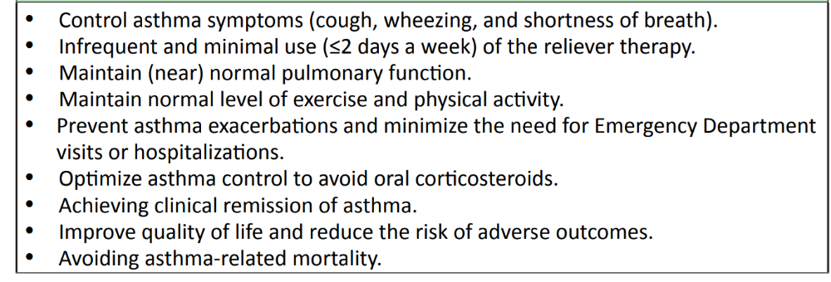
Long Term Goals of Management

Slide 29
Reasons for Non-Adherence
Poor inhaler technique
A regimen with multiple drugs or devices
Medications side effects from the drugs
Medications’ cost
Lack of knowledge about asthma
Lack of partnership in asthma management
Inappropriate expectations
Underestimation of asthma symptoms
Use of unconventional therapy
Cultural issues

Slide 30
Patient-Doctor Partnership
Enhance the chance of disease control
Agreed goals of management
Guided self-management plan

Slide 31
Precipitating Factors
Indoor Allergens and Air Pollutants
Outdoor Allergens
Occupational Exposure
Food and Drugs

Slide 32
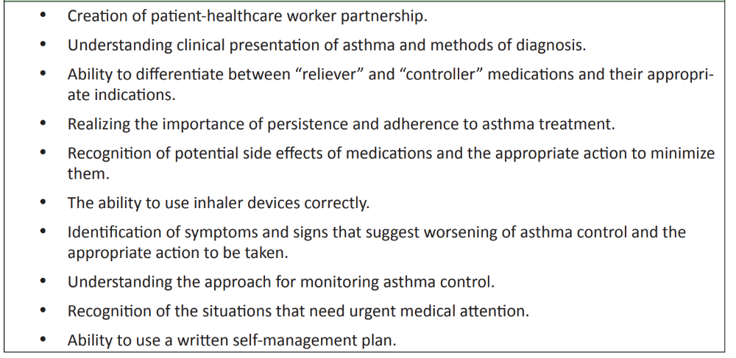
Outcomes of asthma education program

Slide 33
Asthma Medications
Relievers: medications used on an “as-needed basis that act quickly to reverse bronchoconstriction and relieve symptoms
Controllers: medications taken daily on a long-term basis to keep asthma under clinical control

Slide 34
Self-Management plan
A written self-management action plan should be offered to patients
A wide variety of plans are available:
  Patient-based plan
  Physician-based plans
Action plan enhances patient adherence

Slide 35
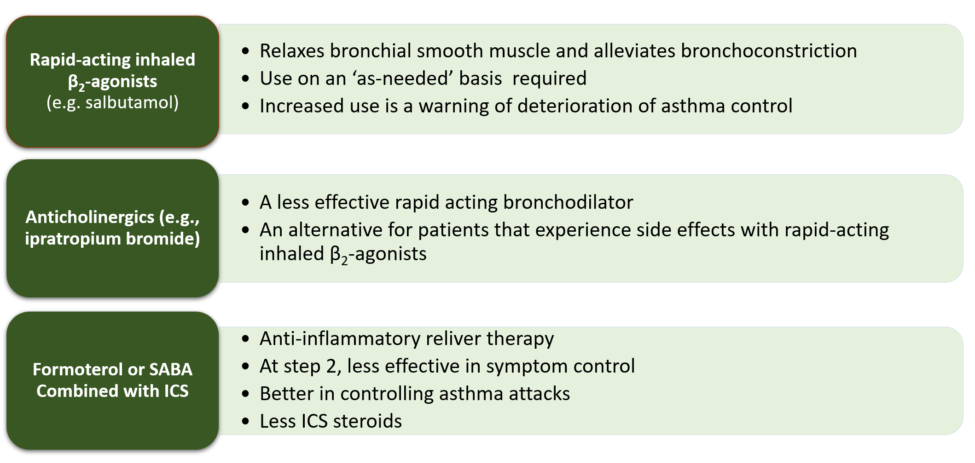
Relievers
Notes:
The table above details the features of available reliever medications
Reliever medications should be provided as needed at all treatment steps for the quick relief of symptoms
The over use of systemic steroids is common in primary care, resulting in side effects
Side effects of oral corticosteroids that are used on a short-term basis include:
an increase in appetite
weight gain
insomnia
fluid retention
mood changes, such as feeling irritable, or anxious.
Side effects of oral corticosteroids used on a long-term basis (longer than three months) include:
osteoporosis
hypertension
diabetes
weight gain
increased vulnerability to infection
cataracts and glaucoma
thinning of the skin
bruising easily
muscle weakness.

Slide 36
Updated Controller Therapy List
Inhaled steroid
Systemic steroid
Long Acting B2 Agonists
Long acting Anti-cholinergics
Leukotrienes Modifiers
Theophylline
Biologics therapy
    Anti IgE: Omalizumab
    Anti IL-5 Ab: Mepolizumab
    Anti IL-5 receptors Ab: Benralizumab
    Anti IL-4 receptors AB: Dupilumab
    Anti TSLP: Tezepelumab

Slide 37
Inhaled Corticosteroids
The most effective anti-inflammatory medications
Benefits of ICS:
  reduce symptoms
  improve quality of life
  improve lung function
  decrease airway hyperresponsiveness
  control airway inflammation
  reduce frequency and severity of exacerbations, and reduce mortality

Slide 38
Inhaled Corticosteroids
ICS are generally safe and well-tolerated
When ICS discontinued, deterioration of clinical control may follow
Most of the benefits from ICS are achieved at relatively low doses
Higher doses associated with increased risk of side effects
Tobacco smoking reduces the responsiveness to ICS
Add-on therapy is preferred to increasing the dose of ICS
Though low-medium dose of ICS may affect growth velocity, this effect is clinically insignificant and may be reversible.

Slide 39
Inhaled Corticosteroids: Side Effects
Local adverse effects:
  dysphonia – may be e reduced by using MDI with spacer devices and mouth washing
  oropharyngeal candidiasis
  Systemic side effects are occasionally reported with high doses and long-term treatment

Slide 40
Short-Acting B₂-Agonists
The medications of choice for symptoms relief
Pretreatment for exercise-induced bronchoconstriction
Formoterol is used for symptom relief because of its rapid onset of action
Increased daily use is a warning of deterioration of asthma control
Side effects: B₂-agonists are associated with adverse systemic effects such as tremor and tachycardia.

Slide 41
Leukotriene modifiers (LTRA)
LTRA reduces airway inflammation
LTRA improves asthma symptoms and lung function
It has less consistent effect on Attacks when compared to ICS
Alternative treatment to ICS for patients with mild asthma, especially in those who have clinical rhinitis
Can be used for aspirin-sensitive asthma

Slide 42
Leukotriene modifiers (LTRA)
Available as Montelukast in Saudi Arabia
Their effects are generally less than that of low dose ICS
When added to ICS, LTRA may reduce the dose of ICS required by patients with uncontrolled asthma, and may improve asthma control
LTRA are generally well-tolerated
There is no clinical data to support their use <6 months

Slide 43
Long-Acting Bronchodilators
LABAs - twice a day:
  Formoterol
  Salmeterol
Ultra LABAs-once daily
  Vilanterol
  Indacaterol
  Olodaterol
Should not be used as monotherapy as it may mask inflammation
Should be combined with ICS
Formoterol combined with ICS can be used as a reliver therapy
Fewer systemic adverse effects:
  Cardiovascular stimulation
  Skeletal muscle tremor
  Hypokalemia

Slide 44
Combination of LABA and ICS
  Improves symptoms
  Decreases nocturnal asthma
  Improves lung function
  Decreases the use of rapid-onset inhaled B2-agonists
  Reduces the number of exacerbations
  Achieves clinical control of asthma in more patients, more rapidly, and at a lower dose of ICS

Slide 45
Long Acting Anti-Chlenergics
Approved agents:
  Tiotropium bromide: Available as a single agent
  Umeclidinium: Available in combination with fluticasone furoate and vilanterol
Superior to a doubling the dose of an ICS at step 3
Non-inferior to LABA
Improves lung function in patients with severe uncontrolled asthma
Add-on therapy to combination devices at step 4
Daily home peak expiratory flow measurements were higher with tiotropium doses

Slide 46
Long-term oral steroid
Last resource for uncontrolled asthma despite maximum therapy
It is limited by the risk of significant adverse effects
Withdrawal can elicit adrenal failure
Prophylactic treatment for osteoporosis should be considered In patients prescribed long-term systemic steroids
Side effects:
  Osteoporosis, hypertension, diabetes, adrenal insufficiency, obesity, cataracts, glaucoma, skin thinning, and muscle weakness

Slide 47
Biologics Agents
Anti IgE: Omalizumab
Anti IL-5 Ab: Mepolizumab
  Anti IL-5 receptors Ab: Benralizumab
    Anti IL-4 Ab: Dupilumab
    Anti TSLP: Tezepelumab

Slide 48
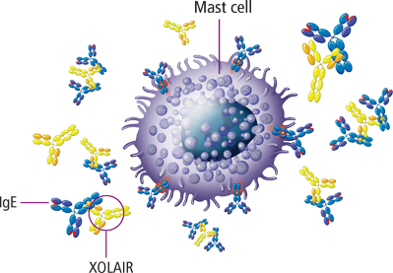
Anti-IgE - Omalizumab
  Received approval 2002
  Indications:
  Severe persistent allergic asthma
  Positive skin test or in vitro reactivity to a perennial aeroallergen
  Uncontrolled asthma at step 4 and 5
  Reduced lung function (FEV1 <80%)
  Indicated for eligible patients >6 years

Slide 49
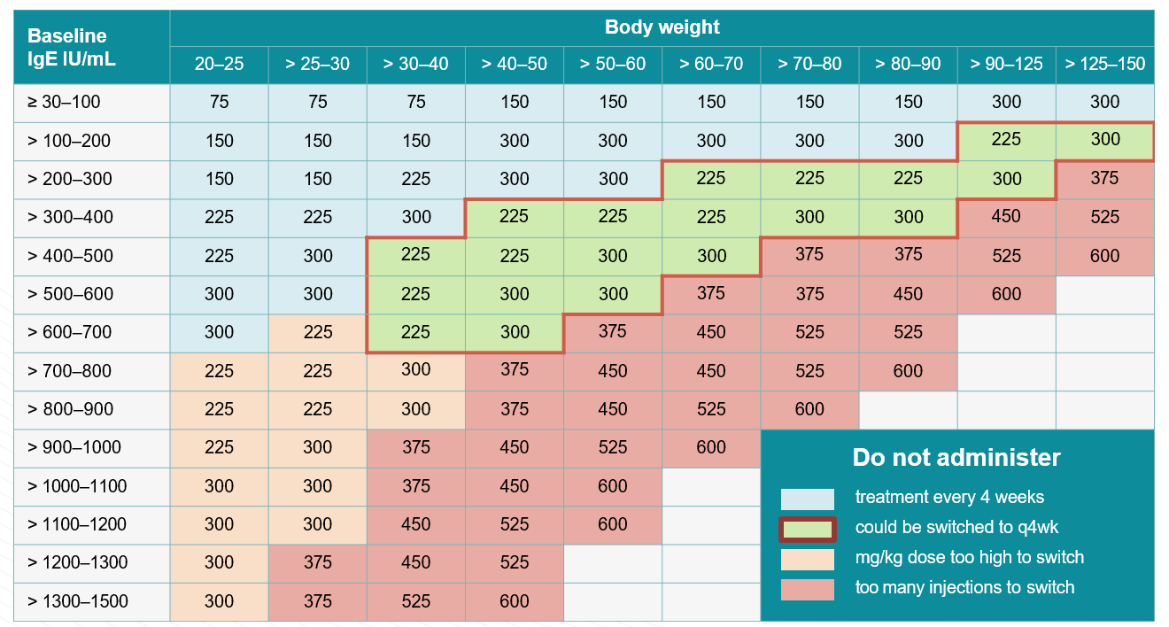
2015: Dose Depends on IgE level and Weight
Notes:
145_Lowe_Regul Toxicol Pharmacol_2015

Slide 50
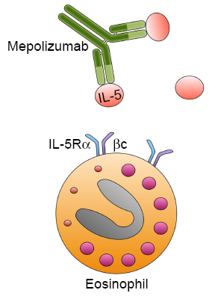
Anti-IL-5 - Mepolizumab
  Received approval 2015 for age >12 years (>6 years in Europe)
  Targeted anti-IL-5 is indicated for severe eosinophilic asthma
  Dose: 100 mg SQ every 4 weeks
  Indications:
      Uncontrolled on high dose ICS and other controllers
      ≥ 2 exacerbations in the past 12 months
      Blood eosinophil level of:
        ≥150 cells/uL at treatment initiation
        ≥300 cells/uL in the prior 12 months
  Discontinuation: at 6-12 months if no response
Ortega et al. NEJM 2014; 371:1198

Slide 51
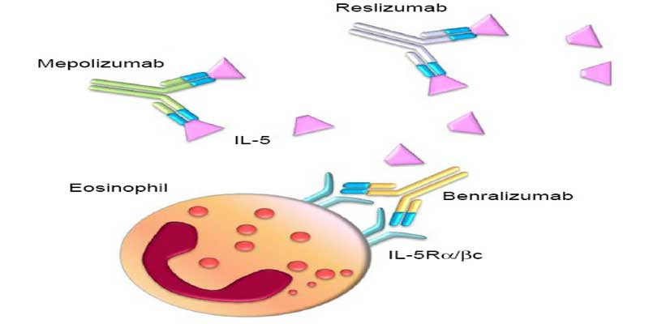
Anti IL-5 Receptors Ab - Benralizumab
  Received approval in November 2017 for age >12 years
  Dose: 30 mg SQ every 8 weeks; first 3 doses every 4 weeks
  Improved asthma control and lung functions
  Indication:
    Severe eosinophilic asthma
    Blood eosinophils >300 cells/ul at initiation of treatment
  Side Effects: Pyrexia, tachycardia, nasopharyngitis, and worsening asthma
  Discontinuation: at 6-12 months if no response
FitzGerald et al. The Lancet 2016; 388: 2128

Slide 52
Anti IL-4 Receptors Ab Dupilumab
  Received FDA approval in November 2018
  Age: >12 years
  Indication:
    Moderate - severe eosinophilic/type 2 asthma with blood eosinophils >300 cells/ul at initiation of treatment
    oral steroids dependent severe asthma regardless of eosinophil count eosinophils mg every two weeks
  Side Effects:
    URTI : at 12 months if no response
    Avoid using live vaccines

Slide 53
Principles of Management
The principles of asthma management will follow 3 stages:
Initiation
Adjustment
Maintenance

Slide 54
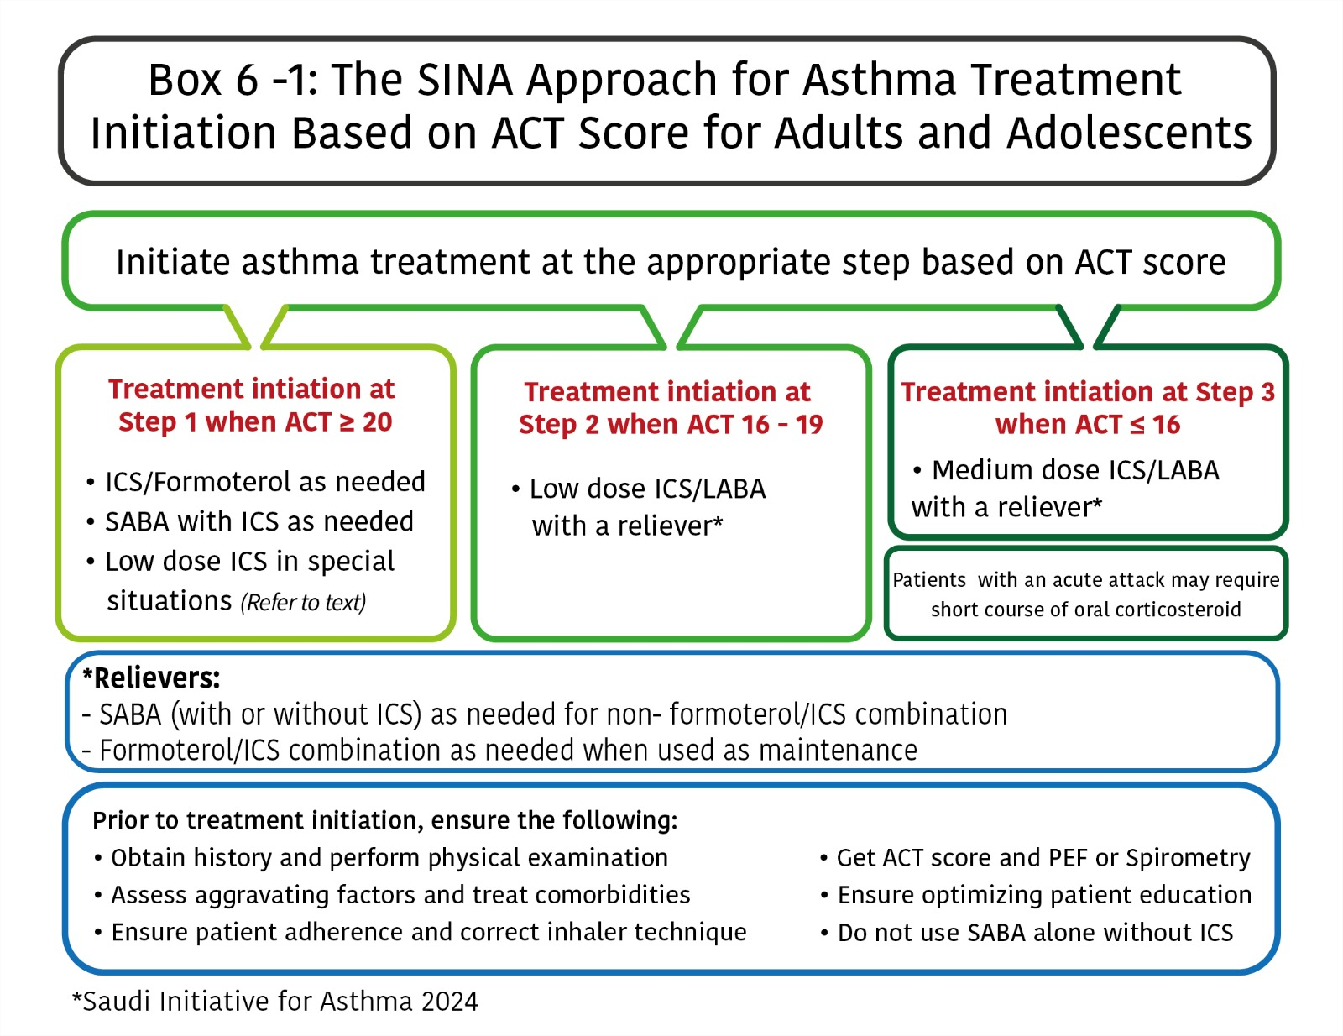

Slide 55
Adjustment of Treatment
Clinical Assessment
Assess control status (GINA symptoms assessment or ACT) and perform PFM
Based on control status, adjust treatment:
  Controlled Status → Maintain treatment with lowest ICS dose
  Partially controlled Status (ACT= 16-19: ) →Step up one step
  Uncontrolled Status → Step up at least one step
Follow-up at 1–3-month intervals as appropriate
Introduce self-management plan

Slide 56
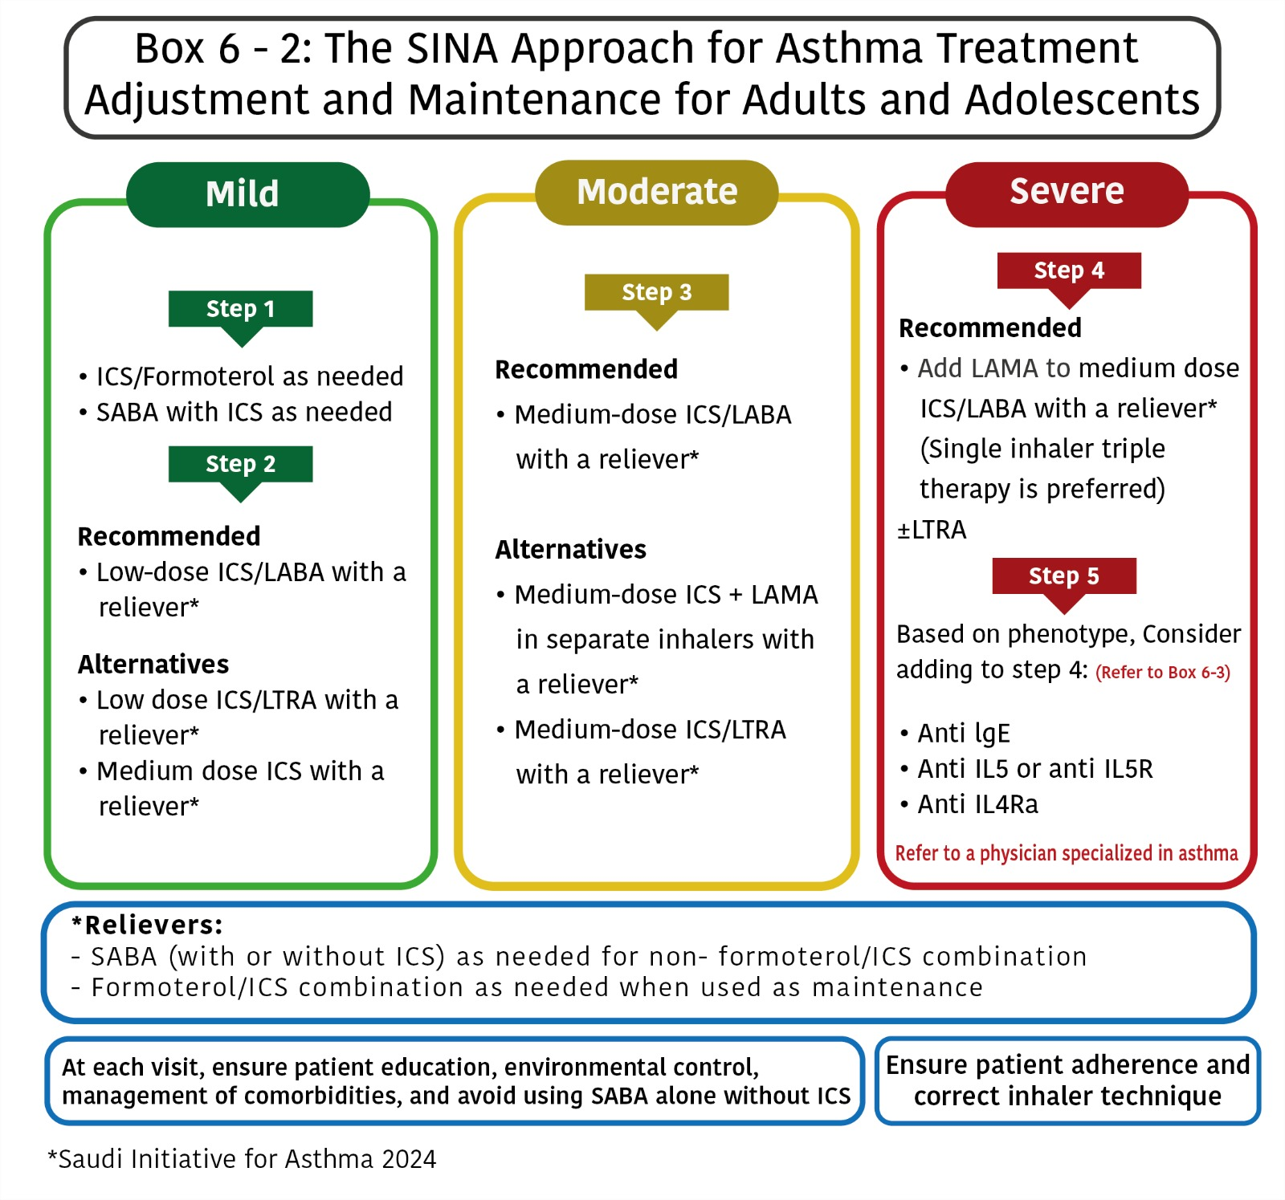

Slide 57
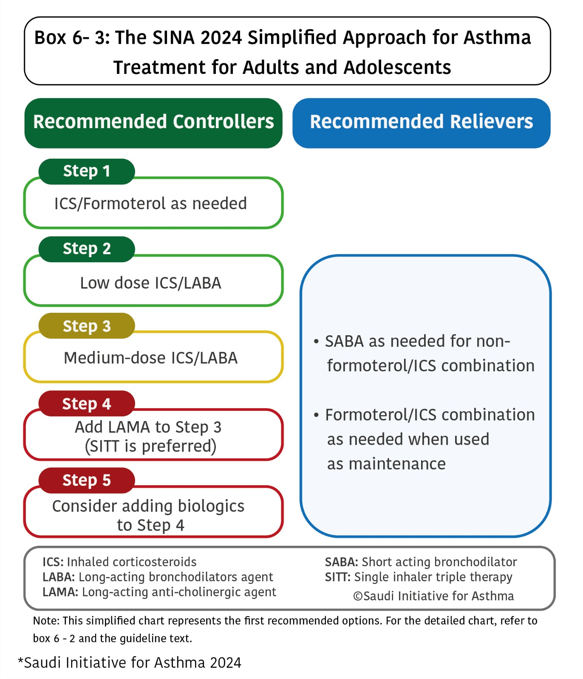

Slide 58
Principles of Asthma Treatment
Daily long-term controller medication is the corner stone of treatment
ICS are considered as the most effective controller
Relievers medications must be available at any step
Reliever medications should be taken on “as needed Basis” to relieve symptoms
Increasing use of reliever treatment is an early sign of worsening asthma control

Slide 59
Principles of Asthma Treatment
Treat patients who may have seasonal asthma as having uncontrolled asthma during the season, then at step 1 for the rest of the year
Patients who had two or more exacerbations requiring oral corticosteroids or hospital admissions in the past year, should be treated as patients with uncontrolled asthma

Slide 60
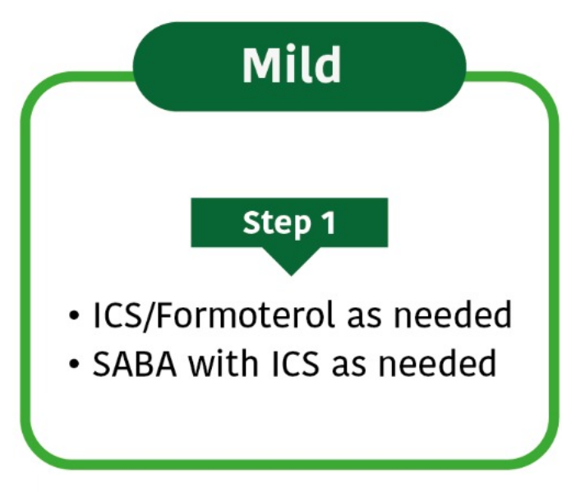
Mild Asthma - Step 1
Mild and infrequent symptoms that fulfilled the criteria for controlled status at the time of treatment initiation (ACT: 20 – 25)
Recommended options:
  Formoterol/ICS combination as needed
  SABA with ICS as needed

Slide 61
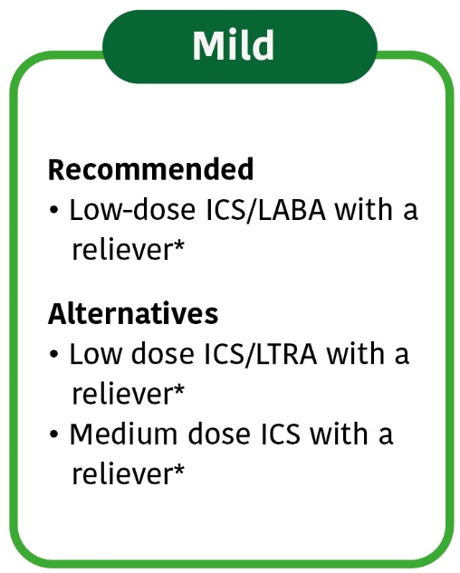

Mild Asthma - Step 2
Mild and infrequent symptoms that fulfilled the criteria for controlled status at the time of treatment initiation (ACT: 20 – 25)
Recommended options:
  Low maintenance dose ICS/LABA with a reliever
Alternative option:
  Low maintenance dose ICS/LTRA with a reliever
  Medium maintenance dose ICS with a reliever

Slide 62
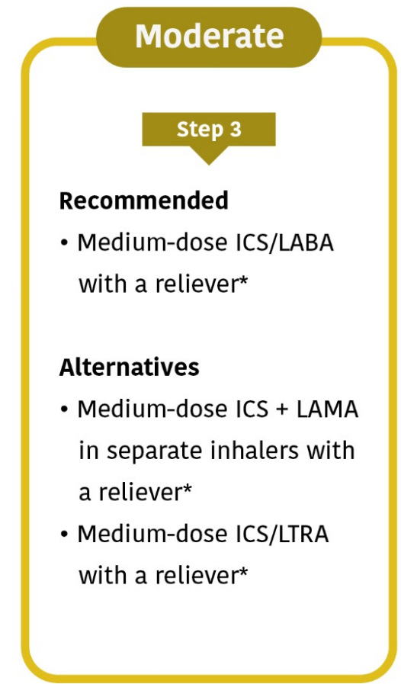

Moderate Asthma - Step 3
Recommended options:
Daily medium-dose ICS/LABA for patients whose asthma is uncontrolled at Step 2, such as:
  Twice a day combination of ICS and LABA
  Once a day combination e.g., Fluticasone furoate (100 mcg)/ vilanterol

Slide 63
Moderate Asthma - Step 3
Alternative options :
Adding LAMA (tiotropium) to medium-dose ICS in separate inhalers
Adding LTRA to medium-dose ICS, especially those with concomitant rhinitis or
Increasing ICS dose to the medium to high dose range as a monotherapy
Consultation with a specialist is recommended for patients whenever there is a difficulty in achieving control

Slide 64
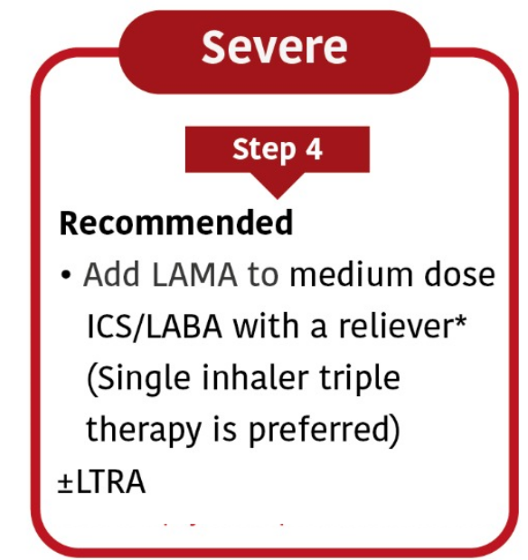
Severe Asthma - Step 4
Maximizing treatment is recommended by combining medium-dose ICS with LABA. If control is not achieved at Step 3, consider the following options:
Adding LAMA to medium-dose ICS/LABA combination:
  Using the triple therapy of fluticasone furoate (200 mcg), vilanterol, and Umeclidinium (preferred option)
  Adding tiotropium to the existing ICS/LABA combination
Adding LTRA to medium-dose ICS/LABA combination
Consultation is recommended

Slide 65
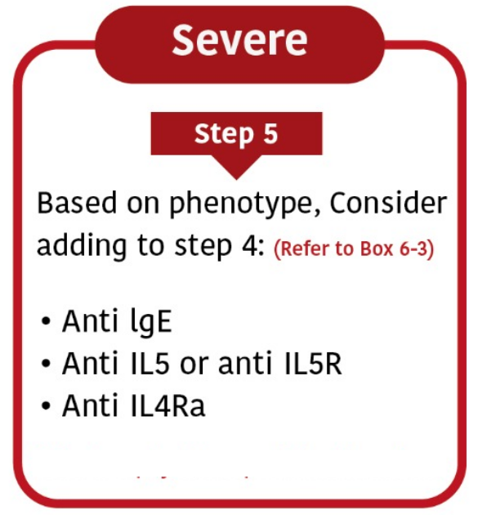
Severe Asthma - Step 5
If control is not achieved at step 4, ensure patient adherence, compliance, and management of comorbidities
Consider a biological agent as appropriate:
  Anti IgE therapy: Omalizumab
  Anti IL5 therapy: Mepolizumab
  Anti IL 5 receptor therapy: Benralizumab
  Anti IL4 therapy: Dupilumab
  Anti TSLP: Tezepelumab
For those who are not candidates for biologics, consider:
  Low dose oral corticosteroids
  Macrolides
Consultation with an Asthma Specialist is strongly recommended

Slide 66
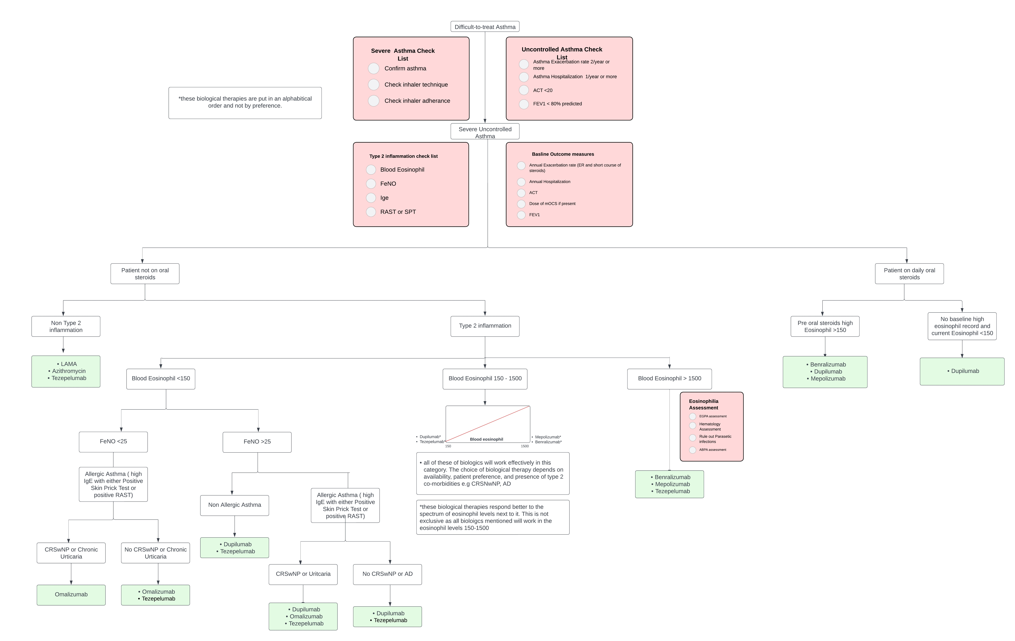
Approach to Biologics

Slide 67
Severe Asthma - Step 5 – long term steroids
Preclusions for long-term systemic corticosteroids:
  lowest possible dose to maintain control
  Monitor for the development of side effects
  Continue attempts to reduce the dose
  Maintaining high-dose of ICS therapy
  Strongly consider concurrent treatments with calcium supplements and vitamin D

Slide 68
Maintaining Control
Clinical Assessment
Assess control status (GINA symptoms assessment or ACT) and perform PFM
Based on control status, adjust treatment:
  Controlled Status → Maintain treatment with lowest ICS dose (may step down)
  Partially controlled Status (ACT= 16-19: ) →Step up one step
  Uncontrolled Status → Step up at least one step
Follow-up at 1–3-month intervals as appropriate

Slide 69
Referral to an Asthma Specialist
Uncertainty regarding the diagnosis
Difficulty achieving or maintaining asthma control
Immunotherapy or biologic therapy are being considered
Difficulty to achieve asthma control at step 3 or higher
Acute asthma attack requiring hospitalization
Request of a patient for second opinion or further advise.

Slide 70
Allergen-specific immunotherapy (AIT)
To desensitize patients to specific allergens
For those with stable asthma and evidence of clinically relevant allergic sensitization; especially if they have coexisting allergic rhinitis
It is not for patients with poorly controlled asthma
No evidence to impact asthma attacks and quality of life
It has specifically been shown to:
  Improve symptoms and stepping down asthma treatment
  Improve airway hyperresponsiveness
  Decrease the progression of allergic rhinitis to asthma
  Decrease the chance of development of new sensitizations

Slide 71
Allergen-specific immunotherapy (AIT)
Two types of AIT in clinical practice:
  Subcutaneous immunotherapy (SCIT) that has better clinical efficacy of SCIT
  Sublingual immunotherapy (SLIT) that has a better safety profile
AIT may rarely cause anaphylaxis
Caution should be taken in patients using beta-blockers
AIT has been used safely in children >5 years of age
AIT needs patient’s commitment for at least 3 years
Pregnancy: AIT can be continued, but not initiated, during pregnancy
Referral to an allergist is recommended to explore this option further

Slide 72
Severe vs. Difficult to Treat Asthma
Severe asthma: are those for whom alternative diagnoses have been excluded, comorbidities have been treated, triggers have been removed, and compliance with treatment has been checked, but remain poorly controlled or with frequent, severe exacerbations despite the prescription of high-intensity treatment or who require systemic corticosteroids to maintain asthma control
Difficult-to-control: are those in whom control is poor due to adherence issues and comorbidities

Slide 73
Severe Asthma
Severe asthma probably accounts for 5–10% of adult asthma
Health cost is disproportionally high
Morbidity and mortality are also higher
Patients must undergo a systematic assessment where the diagnosis of asthma is confirmed, and comorbidities are identified and treated
If biologics or other modalities are not indicated or not available, oral steroids may be considered
  Use the lowest possible dose and to shorten the duration as much as possible
  Osteoporosis prophylaxis is recommended
Pseudo-steroid resistance: patients with persistent symptoms despite high doses of ICS and other "non-steroidal" asthma therapy

Slide 74
Common Comorbidities with Severe Asthma
Allergic rhinoconjunctivitis
Rhinosinusitis/nasal polyps
COPD
Vocal cord dysfunction
Anxiety/depression
Obstructive sleep apnea
Gastroesophageal reflux
Bronchiectasis
Allergic bronchopulmonary aspergillosis

Slide 75
Evaluation of a Patient with Severe Asthma
Be aware of possible misdiagnosis
Assess for the existence of comorbidities that can worsen asthma and makes it difficult to manage
Medications over use or side effects
Managing any psychosocial contributing factors
Identify confounding factors such as:
  Presence of allergens at home or work
  Active or passive smoking and vaping
  psychosocial problems

Slide 76
Other modalities for Severe Asthma
Macrolides:
  Azithromycin at a dose of 250-500 mg 3 days/week as add-on therapy for 48 weeks
  Significantly reduced the experience of at ‘least one asthma attack’ from 61% to 44%
  Significantly improved asthma-related quality of life measures

Slide 77
Asthma in Special Situations

Slide 78
Asthma and pregnancy - 1
Unpredictable course: one third may have worsening of asthma control
Maintaining adequate asthma control during pregnancy is essential
Identifying and avoiding triggering factors should be the first step of therapy for asthma during pregnancy
Continuous fetal monitoring in severe asthma exacerbation
If anesthesia is required during labor, regional anesthesia is recommended whenever possible
The use of prostaglandin F2α may be associated with severe bronchospasm

Slide 79
Asthma and pregnancy - 2
Same stepwise approach as in non-pregnant patient.
Salbutamol is the preferred SABA
ICSs are the preferred controllers
Use of ICS, theophylline, antihistamines, B2-agonists, and LTRA is generally safe
Acute exacerbations of asthma during pregnancy should be treated on the same outlines as in non-pregnant patients

Slide 80
Cough-variant asthma
Cough is the main symptom
It is common in children, and is often more problematic at night
Other diagnoses to be considered are:
  Drug-induced cough caused by angiotensin-converting-enzyme inhibitors
  GERD
  Postnasal drip and chronic sinusitis
Treatment is similar to long-term management of asthma

Slide 81
Exercise-induced Asthma
Bronchoconstriction peaks within 10 to 15 minutes after completing the exercise and resolves within 60 minutes.
Prevention:
  SABA before exercise
  Warm-up period before exercise
  Some patients may need maintenance therapy
  Regular use of LTRA may help in this condition especially in children

Slide 82
Aspirin/NSAID induced Asthma
Occurs in 10–20% of adults with asthma
The majority experience first symptoms during the third to fourth decade.
Once aspirin or NSAID hypersensitivity develops, it is present for life.
Within 1-2 hours following ingestion of aspirin, an acute, severe attack may develop, and is usually accompanied by rhinorrhea, nasal obstruction, conjunctival irritation, and scarlet flush of the head and neck
Prevention by avoidance of aspirin/NSAID
They should be referred to an allergy specialist for aspirin desensitization
Aspirin and NSAID can be used in asthmatic patients who do not have aspirin induced asthma

Slide 83
GERD triggered asthma
GERD is more prevalent in asthmatics
Mechanisms of GERD triggered asthma:
  vagal mediated reflex
  reflux of micro-aspiration of gastric contents into the upper airways
If GERD symptoms presents, a trial of GERD therapy for 6–8 weeks wit lifestyle modifications
Asymptomatic patients with uncontrolled asthma may not benefit from GERD therapy

Slide 84
Difficult to treat asthma (DTA) - 3
Some patients may have the "pseudo-steroid" resistance in patients with persistent symptoms despite high doses of ICS and other "non-steroidal" asthma therapy
The aim is to reach the best possible outcome as it may be difficult to achieve full control
Patients should be at maximum therapy is given (Step 5 therapy)
Anti-IgE treatment (Omalizumab) is given if the patients fulfill the criteria for this treatment

Slide 85
Management of Acute Asthma

Slide 86
Acute Asthma in Adults
Most patients who present with an acute asthma exacerbation have chronic uncontrolled asthma
The following should be carefully checked:
  previous history of near fatal asthma
  patient taking three or more medications
  heavy use of SABA and frequent ER visits
Patient should be assessed to determine the severity of acute attacks
PEF and pulse oximetry measurements are complementary to history taking and physical examination

Slide 87
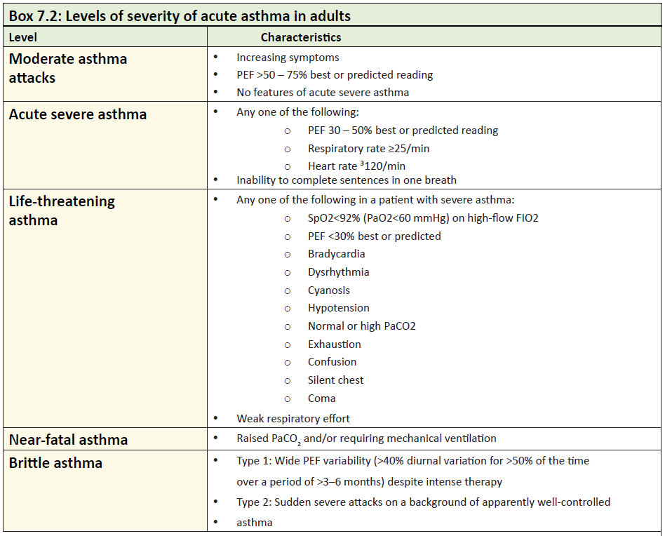

Slide 88
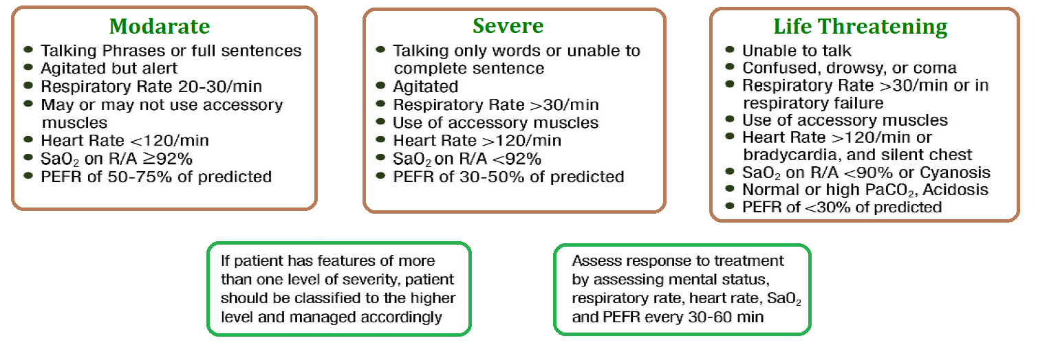
Initial Assessment of Acute Asthma

Slide 89
Medications used in acute asthma
Oxygen
High concentration of inspired oxygen to correct hypoxemia (do not miss COPD)
Pulse oximetry should be used to tailor oxygen therapy
Failure to achieve oxygen saturations of more than 92% is a good predictor of the need for hospitalization
Normal or high PaCO₂ is an indication of a severe attack, and need for specialist consultation

Slide 90
Bronchodilators
Inhaled salbutamol is the preferred choice
Repeated doses is recommended at 15–30 minute intervals.
Alternatively, continuous nebulization (Salbutamol at 5–10 mg/hour) may be used for one hour if there is an inadequate response to initial treatment.

Slide 91
Bronchodilators
Patients who are able to use the inhaler devices, 6–12 puffs of MDI with a spacer are equivalent to 2.5 mg of Salbutamol by nebulizer
In moderate to severe acute asthma, combining ipratropium bromide with Salbutamol has some additional bronchodilation effects, in reducing hospitalizations and greater improvement in PEF or FEV₁

Slide 92
Steroid Therapy
Systemic steroids: reduce relapses and subsequent hospital admission
Oral steroid is equivalent injected steroids
Oral prednisolone: 40–60 mg daily
Systemic steroids should be given for seven days for adults and three to five days for

Slide 93
Magnesium Sulphate
A single dose of IV magnesium sulphate (1.2–2 gm IV infusion over 20 mins) is safe and effective
Routine use of IV magnesium sulphate in patients with acute asthma presenting to emergency department is not recommended.
Its use should be limited to those with sever exacerbation who fail to respond to treatment after an hour

Slide 94
Intravenous Aminophylline
In acute asthma, the use of intravenous aminophylline did not result in any additional bronchodilation compared to standard care with B2-agonists

Slide 95
Antibiotics
Viral infection is the usual cause of asthma exacerbation
The role of bacterial infection has been probably overestimated, and routine use of antibiotics is strongly discouraged
They should be used when there is associated pneumonia or bacterial bronchitis

Slide 96
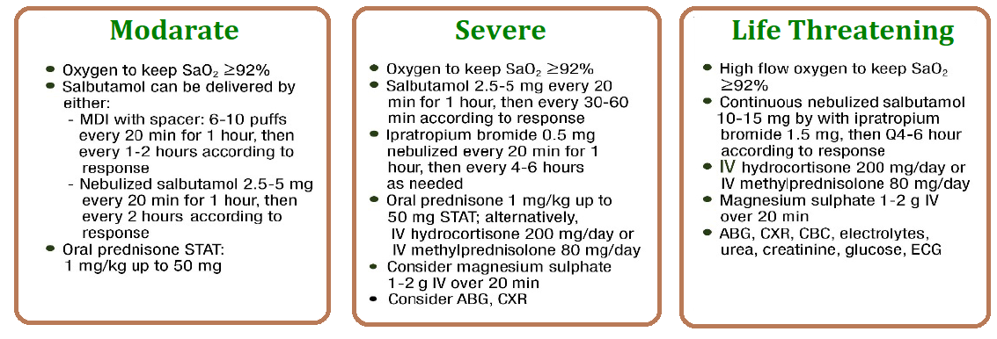
Initial Management of Acute Asthma

Slide 97
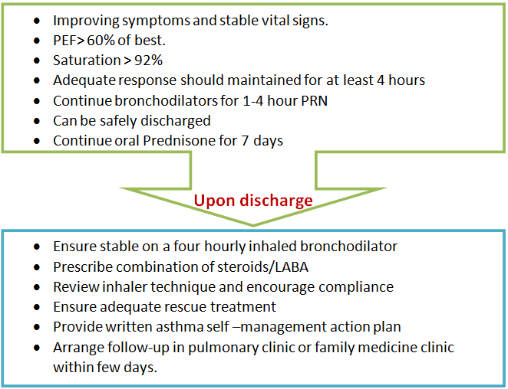
If There is an Adequate Response

Slide 98
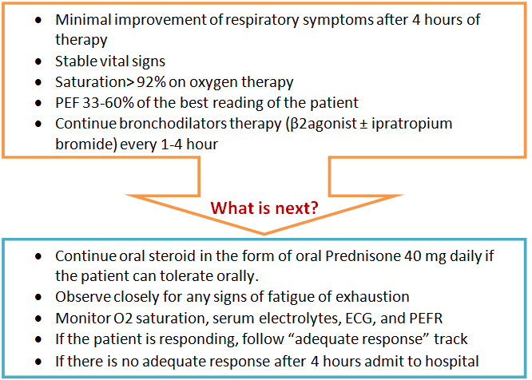
If There is a Partial Response

Slide 99
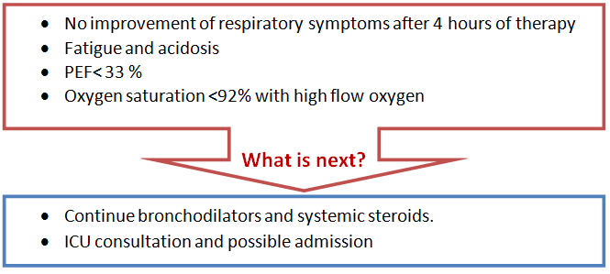
If There is a Poor Response

Slide 100
Referral to a Specialist Center
  Status asthmatics
  Deteriorating PEF
  Persisting or worsening hypoxia
  Hypercapnea, respiratory acidosis (pH <7.3)
  Severe exhaustion
  Increase work of breathing
  Drowsiness
  Confusion
  Coma
  Respiratory arrest

Slide 101
Criteria for Admission
Patients whose peak flow is ≥ 60% best or predicted one hour after initial treatment can be discharged from the emergency department
Criteria for admission:
  Any feature of a life threatening, near fatal attack
  Any feature of a severe attack that persists after initial treatment.
  unless any of the following is present:
  still suffering from significant symptoms
  previous history of near fatal or brittle asthma
  concerns about compliance and pregnancy

Slide 102
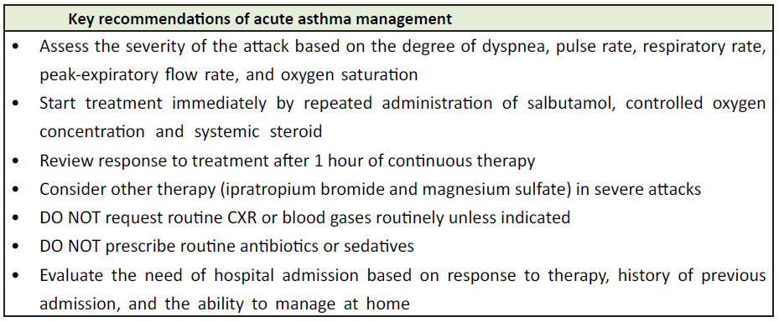

Slide 103
Thank you

